Slide 1
How to reduce infant mortality?
Supervised Learning Capstone
Nadine Ruecker
August 30th 2018
Notes:
Hi everyone, my name is Nadine. Thanks so much for joining to my capstone presentation.
First of all I’d see a lot of people who rsvp’ed for my presentation last week. I apologize, that this was canceled last minute, but I did not have a mentor for evaluation.
In the next couple of slides I will guide you through my approach on answering the question: “ How to reduce infant mortality?”

Slide 2
How to reduce infant mortality?
Outline
Introduction to the problem
Dataset
Data cleaning & preparation for modeling
Classification
Model improvements
Results
Discussion
Supervised Learning Capstone - August 30th 2018
Notes:
Just a brief outline: I will introduce the problem, and the dataset to you. Then I will describe the data cleaning process. I performed a broad classification using different model, but only one worked really well. I will explain you how I improved the performance and used it to answer my question. At the end I hope there will be some time for discussion.

Slide 3
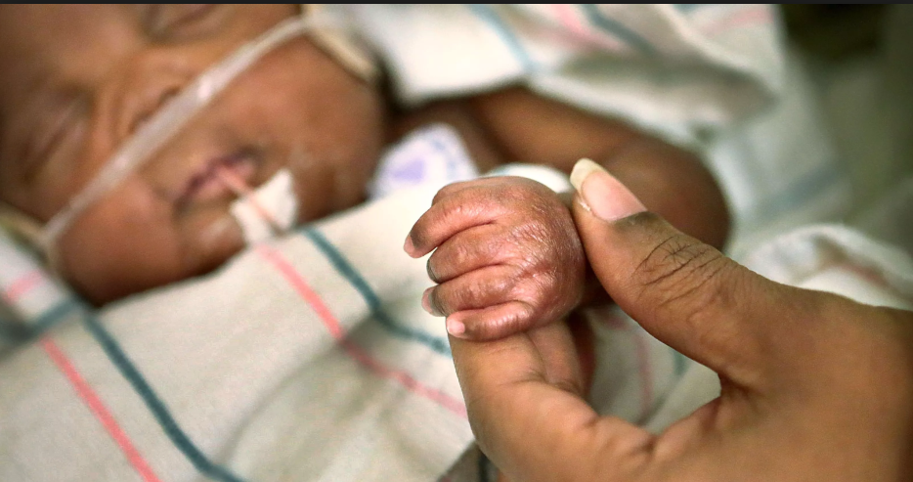
1. Introduction to the problem
Definition
Infant mortality rate (‘SP.DYN.IMRT.IN’):
number of children who die before their first birthday per 1000 life births.
.
Supervised Learning Capstone - August 30th 2018
Notes:
Infant mortality rate is defined as the number of children that die before their first birthday per 1000 life birth. In their millenial goals the UN declared decreasing infant mortality among others a priority. So my questions is what are the most effective ways?

Slide 4
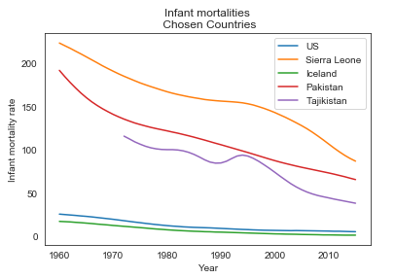
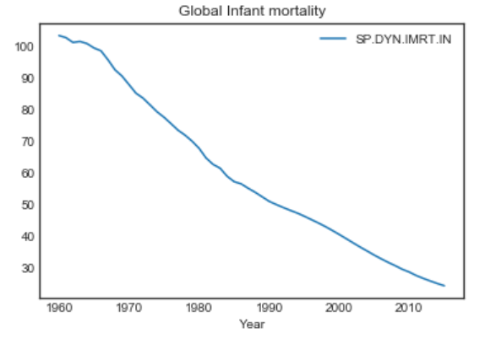
1. Introduction to the problem
Global infant mortality
Supervised Learning Capstone - August 30th 2018
Notes:
Globally the infant mortality has been decreasing. But as you can imagine the range of infant mortality is pretty broad.
Let’s look at a few specific countries. In the US the rates are low. The lowest rates are gained in Iceland. But in other countries the rates are still high.
Sierra Leone has the highest rates, but there has also been a nice drop since 2000. So what where the measures taken during that time. Maybe they could be used as recommendations for other countries.

Slide 5
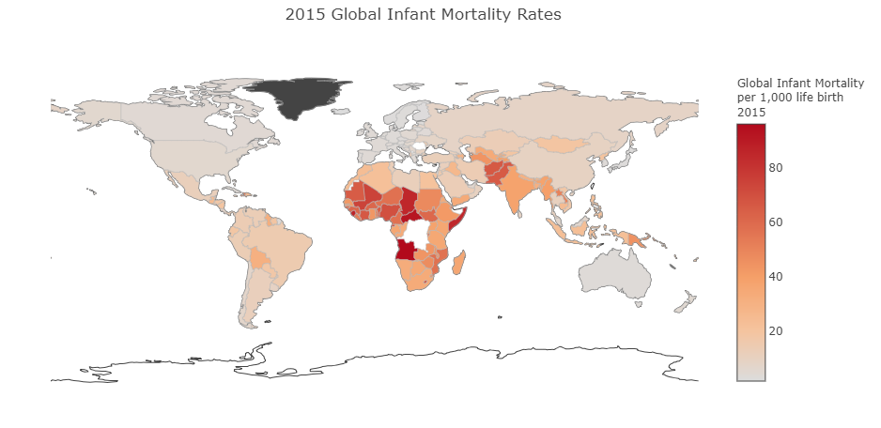
1. Introduction to the problem
Global infant mortality
Supervised Learning Capstone - August 30th 2018
Notes:
Let’s briefly look globally, so there clearly are certain regions with high infant mortality rates, sub Saharan Africa but also western of Asia.

Slide 6
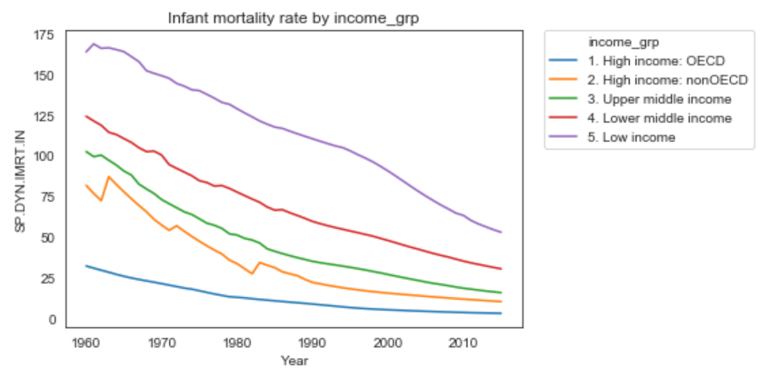
1. Introduction to the problem
Global infant mortality
Supervised Learning Capstone - August 30th 2018
Notes:
You probably guess this one, but just as an illustration. The infant mortality rates are higher in countries with low income. So I will focus my analysis on those.

Slide 7
1. Introduction to the problem
Research question:
How to reduce infant mortality?
Find domains of investment for countries that want to reduce their infant mortality.
Supervised Learning Capstone - August 30th 2018
Notes:
All right so in the following slides I will try to answer the question: How to reduce infant mortality? Or more precisely? What is happening in countries with increases in infant mortality?

Slide 8
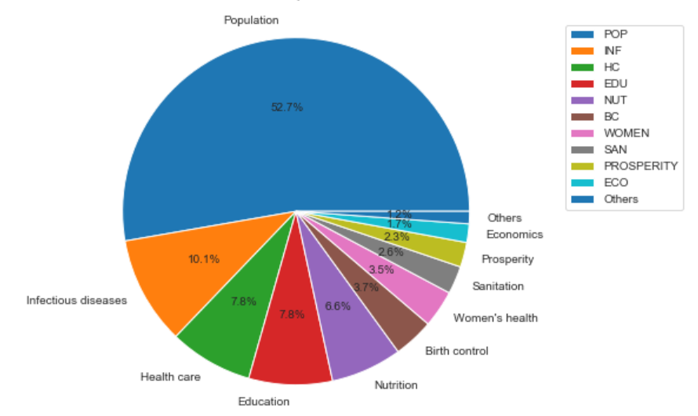
2. Dataset
Overview
https://www.kaggle.com/theworldbank/health-nutrition-and-population-statistics/home
359 features.
263 countries.
From 1960-2016.
Supervised Learning Capstone - August 30th 2018
Notes:
The dataset that originally inspired my questions can be found on Kaggle. It is world bank data, that has been collected for 263 countries annually since 1960.
The dataset has 345 features, but more can be found when visiting the world bank website directly. The features included can be categorized into the following classes: Most of the data is population data, which included among other infant mortality rate, but also adult mortality, and it contains details about the female and male age distribution of each country. Second most common class is infectious diseases: This includes immunization, detection, treatment success rates for life threatening infectious diseases like HIV, malaria, tuberculosis rates. We also have a health care group with variables like numbers of physicians per 1000 people. Further categories include data on education ( school attendance and success rates), nutrition (malnutrition indicator, BMI data, vitamine A supplementation rates coverage)

Slide 9
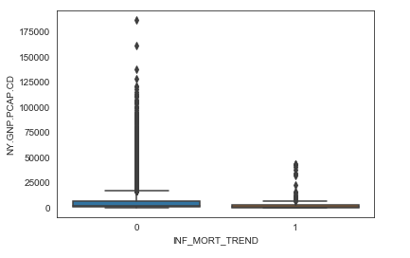
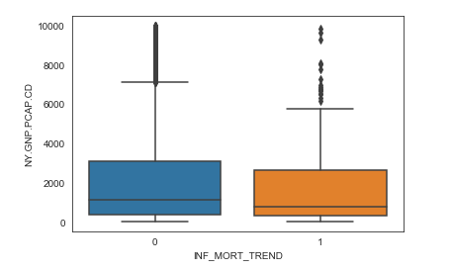
3. Data cleaning & preparation for modeling
target variable and low income countries
data shape
INF_MORT_TREND:
Yearly difference in infant mortality per country:
down= 0, up=1
0 = 13904, 1= 544
NY.GNP.PCAP.CD:
GNI per capita in US$
0 = 7464, 1= 313 => 4%
14448, 359
c
7777, 359
1008,
350
323,
9
Before After
Notes:
First I initiated my target variable:
I calculated the yearly difference of infant mortality rate and converted this into a binary column with 0 meaning the rate dropped and 1 meaning the rate increased. As the rates are globally decreasing, it is not surprising to find an unbalanced dataset with only 544 increases in over 14000 cases.
Next I remove the rich countries, by using a GNI cut off 10.000.
That reduced my dataset to 50%

Slide 10
3. Data cleaning & preparation for modeling
Removing Nans
The dataset has 43.7% Nans.
Dropping all rows or columns with Nans leaves nothing.
1. Mean calculation by subregion.
2. Removed columns with more than 40% Nan.
3. Removed all remaining Nan.
235 countries -> 20 subregions
1980-2009
data shape
14448, 359
7777, 359
c
323,
196
c
323,
9
Supervised Learning Capstone - August 30th 2018
Notes:
Removing Nans was the biggest challenge. The dataset contained 43.7% Nans, so removing either columns or rows with any NA left nothing. I tried thresholding, but could not find an optimum.
Because I had fallen in love so much with the dataset I decided to merge the data into subregions.
That reduced the from 7000 rows to 323 rows and 196 features.

Slide 11
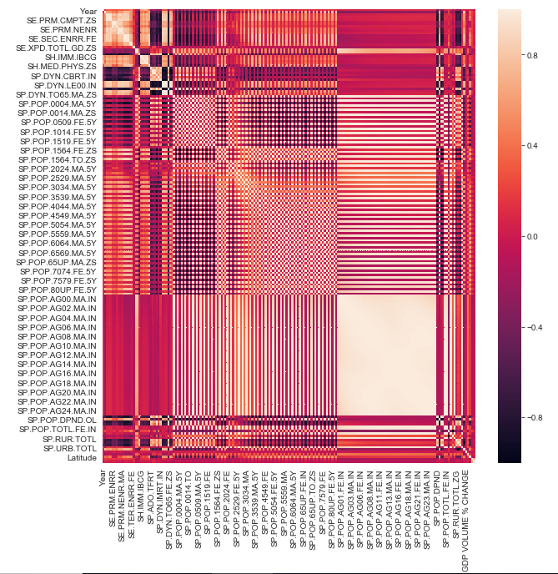
3. Data cleaning & preparation for modeling
Select best features – using correlation
data shape
14448, 359
14448, 359
7777, 359
7777, 359
323,
196
c
323,
9
Notes:
Next I analyzed the correlation of the features with my target. But 196 variables are a lot. So I decided to look at the mean absolute correlation coefficients per feature class.

Slide 12
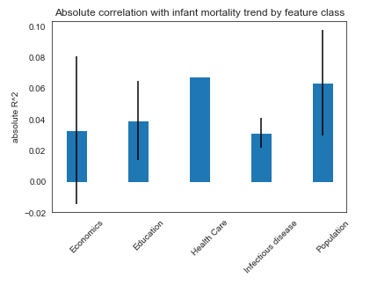
3. Data cleaning & preparation for modeling
Select best features – using correlation
data shape
14448, 359
7777, 359
323,
196
c
323,
9
Notes:
Here we can see, that the feature class with the highest correlation is health care. Followed by population. But all classes have high standard deviations, so they included important and unimportant features.
I decided to clean each group separately and keep the most predictive features from each group. Which left me with 9 numerical features, plus subregion.

Slide 13
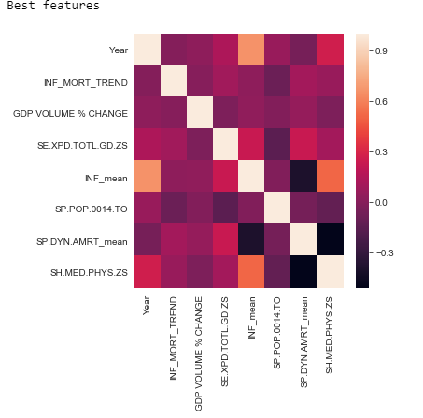
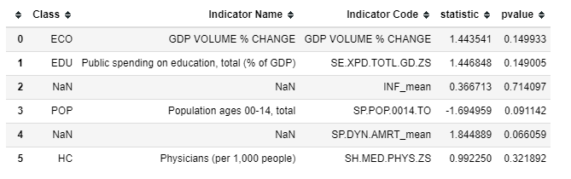
3. Data cleaning & preparation for modeling
Chosen features
INF Immunization rates averaged
POP Adult mortality rates averaged
Supervised Learning Capstone - August 30th 2018
Notes:
This was a lot of cleaning. The feature are do not show severe collinearity anymore. But when I calculated p-values for each feature comparing the target groups, none of the features is significantly different among the two test groups.

Slide 14
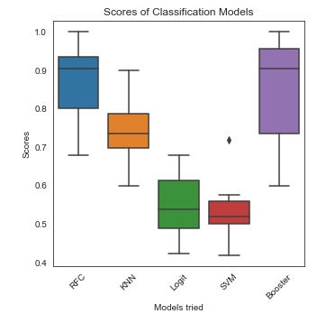
4. Classification
Which classifier performs best?
Subregion -> binary
Infant mortality decreases: 245
Infant mortality increases: 42
17%
=> Oversample
Supervised Learning Capstone - August 30th 2018
Notes:
Cases of infant mortality increase were underrepresented in my dataset, therefore I oversampled those before running the model. As infant mortality increases were with 17% underrepresented in my dataset. Then I tried several classifiers, in a 10 fold cross validation.
Random Forest and a gradient booster model performed best. In the following slides I will focus on the random forest classification.

Slide 15
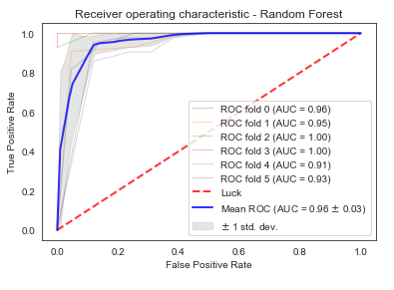
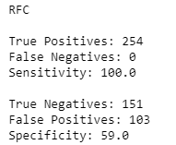
4. Classification
Random forest details
Supervised Learning Capstone - August 30th 2018
Notes:
With the oversampling the random forest reached a sensitivity of 100% but lacked in specificity, with an accuracy of 96% this is however already a pretty good prediction. So what are the most important features?

Slide 16
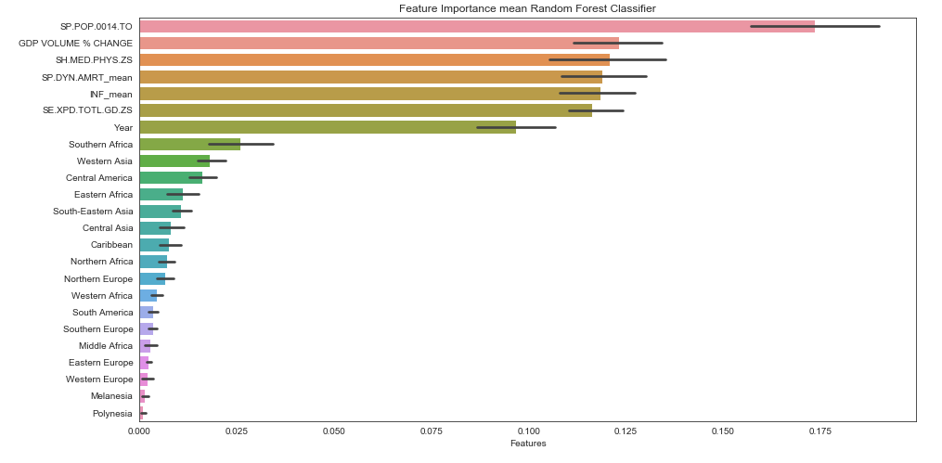
4. Classification
Feature importance
Supervised Learning Capstone - August 30th 2018
Notes:
The most important features are: The total population between 0-14 years, GDP % volume change, public spending for education, immunization and adult mortality.
The total number of children is a features that is hard to interpret. I will further go into this in the result section.
If I only use one of those top 5 features, will I be abled to improve my specificity?

Slide 17
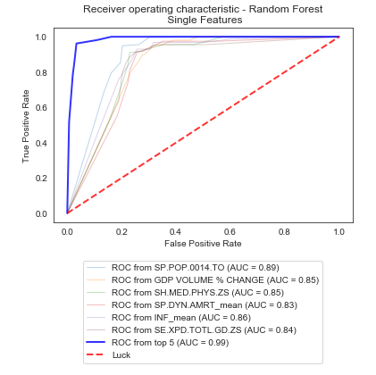
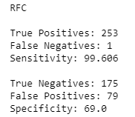
5. Model improvements
RFC optimization
Supervised Learning Capstone - August 30th 2018
Notes:
I repeated the RFC with all top 5 features and with each feature alone. But not even the most predictive feature “Total population between 0-14 years” yielded as good of an accuracy as the model with all features.
However, when using all 5 features together, I was abled to improve the specificity and yielded an accuracy of .99, compared to 0.96 when using all features.

Slide 18
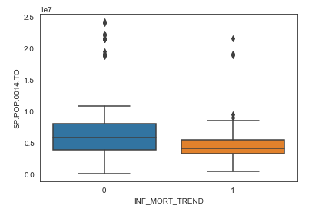
6. Results & Discussion
How to reduce infant mortality?
Top 1+5 features:
Total population between 0-14 years
GDP % volume change
Physicians (per 1,000 people)
Immunization
Adult mortality
Public spending on education (%GDP)
Supervised Learning Capstone - August 30th 2018
Notes:
So, how can infant mortality be reduced?
The most predictive features is total population between 0-14 years. The feature is a little bit difficult to interpret.
I think it might mean, that in critical times, people have less children. When they know, their kids would suffer economically or politically instable situation, people might postpone their family planning or decide not to have kids at all.
But all other features can actually be translated into action items:
Increase your GCP, spend more on education, improve immunization rates and decrease adult mortality.

Slide 19
6. Results & Discussion
Discussion & Outlook
Better model using PCA, but that would have not allowed to answer my question
Handle missing data differently
-> merge by subregion, smoothed extreme effects
- Infant mortality is probably impacted by other important factors:
-> war, famine, climate conditions
-> government type
- Data collection accuracy in critical conditions questionable
Supervised Learning Capstone - August 30th 2018
Notes:
Finally let’s critically dissect my approach:
I could have safe a lot of time and nerves probably if I would have used PCA for feature reduction, but that would not have allowed me to answer my question.
I think there probably are better ways to handle the missing data., by merging by subregion I smoothed out extreme effects.
Merging by subregion also prevented me from including additional features like political system or war to the data, because those can’t be averaged as they are categorical data.
Next, things to do could be, starting the analysis all over for with the 5 most predictive features and no merging by subregion.

Slide 20
THANK YOU!
QUESTIONS?
Notes:
Did not even try naïve bayes, because the features are not independent,

